Slide 1
Quality Grading Made Faster and Easier with Turnitin GradeMark
Christopher Krejci, Ph.D., Assistant Professor of English
Kim George, Associate Professor of English
Kimberley Clawson, Professor of Biology/ Biotechnology & Interim Dept. Chair of Biotechnology
Esther Guenat, Associate Professor of English
Zero Week Workshop
Temple College
Temple, TX
January 10, 2017

Slide 2
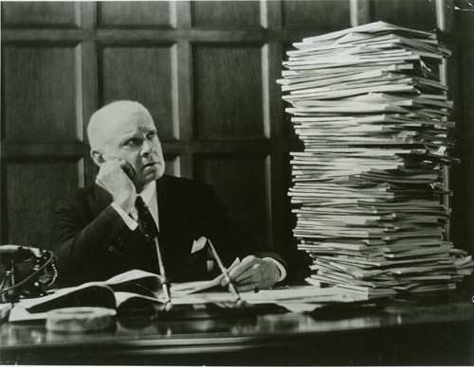
Are you tired of postponing assignments because you fall behind on grading?

Slide 3

Do you feel stressed out by the mere thought of giving students feedback on written assignments?

Slide 4

Halfway through the semester, are you buried in piles of ungraded papers?

Slide 5

Do your graded papers resemble a crime scene?

Slide 6

Have handwritten comments caused you cramps?

Slide 7

Or left students frustrated by your penmanship?

Slide 8

Then it may be time for you to trade in your red pen for Turnitin GradeMark to help you conquer the stack!

Slide 9
What is Grademark?
GradeMark is a feature of Turnitin.com that is already integrated into D2L.
GradeMark makes it easy to evaluate a variety of work (including essays, PowerPoint files, or images) online.
With GradeMark, you can drag and drop preloaded or custom comments into an assignment for students to read via D2L.
You can create and save your own bank of disciplinary-, course-, or assignment-specific comments to use each semester.

Slide 10
Workshop Objectives
This session has been designed to help you tailor GradeMark for your courses to make it faster and easier to provide students with the type of quality feedback they need to achieve success.

Slide 11
Workshop Overview
Next, I will offer a brief summary of research about the type of feedback students need to achieve success and suggest ways GradeMark makes it easier to provide such feedback.
Then, Kimberley Clawson and Esther Guenat will discuss their use of GradeMark in their own courses.
Finally, Kim George will lead a step-by-step demonstration to help you set up GradeMark.

Slide 12
Summary of Research Conducted by Turnitin
According to a study of over 2,000 students and educators from across disciplines, which was conducted by Turnitin (2015), close to 70% of students find typed or written comments “very or extremely effective’’ (p. 6). In contrast, only 39% of educators find typed comments “very or extremely effective’’ and only 31% find written comments “very or extremely effective’’ (p. 6).

Slide 13
Summary of Research Conducted by Turnitin
In this same study, more than 76% of students report that “suggestions for improvement” are “very or extremely effective’’ (p.7).

Slide 14
Summary of Research Conducted by Turnitin
In a webcast to discuss the study, Tupa and Balibalos (2016) argue that “feedback should guide students toward the answers and not give . . . the answers away explicitly” and that “suggesting ways to improve can be very effective if the suggestions focus on the specific task at hand, if they remind students of the learning goals to obtain, and if they demonstrate to students what else they need to do to reach those goals.”

Slide 15
Summary of Research from Journals Outside of Liberal Arts
A study conducted by Holmes and Smith (2013) at a four-year university in the College of Business finds that students complain most about receiving minimal or no feedback to justify grading (p. 321).

Slide 16
Summary of Research from Journals Outside of Liberal Arts
Through a study conducted within a School of Nursing, Ball (2009) finds that handwritten annotations in the margins of assignments may leave students confused and without a clear sense of direction as to how to improve upon their work.

Slide 17
Summary of Research from Journals Outside of Liberal Arts
Based on a study conducted through an introductory marketing class, Smith (2008) argues that “instructors’ grading time and effort, with a modicum of respect and kindness, yield more positive faculty-student interactions” (p. 330).

Slide 18
GradeMark can help instructors provide the type of feedback on assignments that students find to be most effective.
Instructor’s can create, save, and reuse disciplinary-, course-, or assignment-specific comments to suggest improvements, remind students of learning goals, or provide students with examples.
Preloaded comments make it easy for instructors to give students feedback on common errors.
Instructors can include links to outside websites to help explain feedback, offer further guidance, or provide additional practice.
Instructors can build multiple comment banks to categorize different types of feedback, such as a bank of praise for “problem assignments,” which could facilitate more positive faculty-student interactions.

Slide 19
But you don’t have to take my word for it.
Kimberley Clawson and Esther Geunat are here to share their experiences.
And Kim George is ready to guide you through set-up and customization.

Slide 20


With their expertise, Turnitin GradeMark can help you go from woeful to hopeful.

Slide 21
References
Ball, E. (2009). A participatory action research study on handwritten annotation feedback and its impact on staff and students. Systemic Practice & Action Research, 22(2), 111-124. doi:10.1007/s11213-008-9116-6
Holmes, L. E., & Smith, L. J. (2003). Student evaluations of faculty grading methods. Journal of Education for Business, 78(6), 318-323.
Smith, L. J. (2008). Grading written projects: What approaches do students find most helpful? Journal of Education for Business, 83(6), 325-330.
Tupa, S., & Balibalos K. (2016) Instructor feedback writ large: Student perceptions on effective feedback [Video webinar]. Retrieved from http://go.turnitin.com/webcast/student-feedback-study?_ga=1.195939884.1220200496.1481818336
Turnitin. (2015) Instructor feedback writ large: Student perceptions on effective feedback. Retrieved from http://go.turnitin.com/paper/student-perceptions-on-effective-feedback

